Slide 1
What is Programming?
The Role of Programming in the Modern World

Slide 2
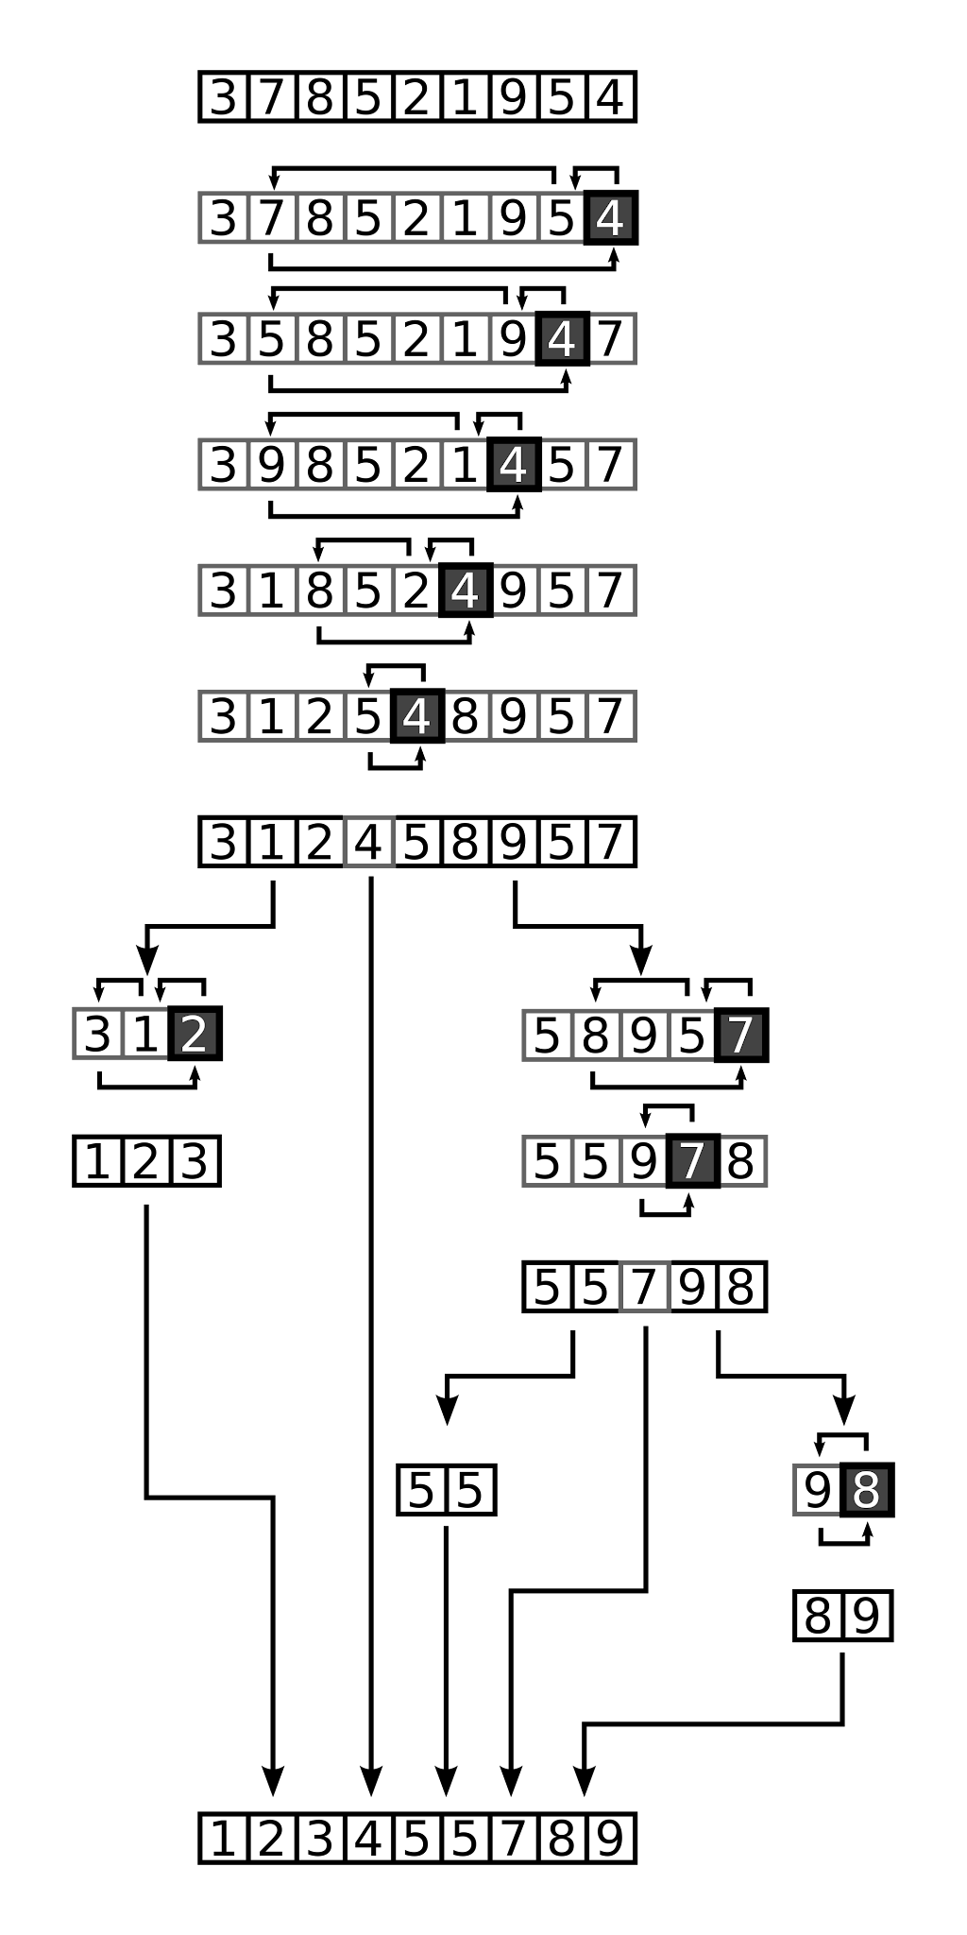
Introduction
Programming is the art of telling a computer what to do through a set of instructions.

Slide 3
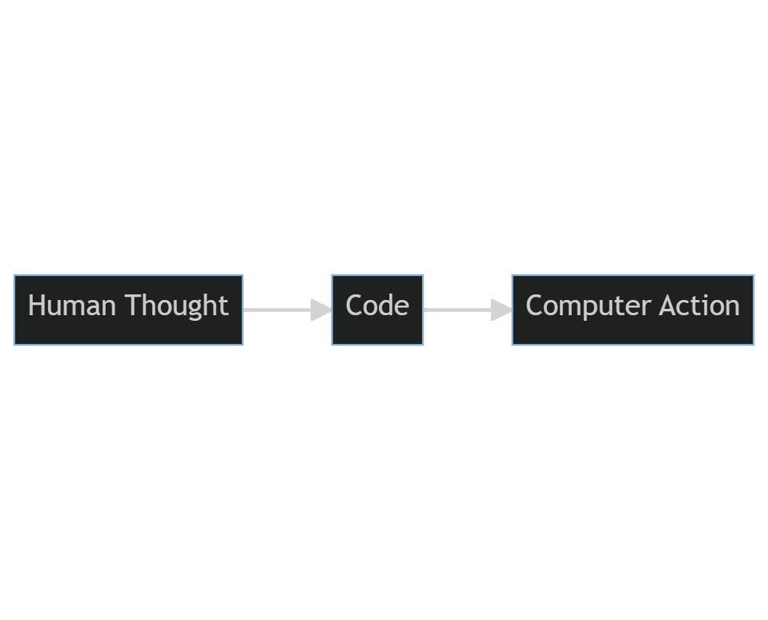
The Essence of Programming
Programming, at its core, is the process of creating a set of instructions that a computer can understand and execute.

Slide 4
From Past to Present
Manual tasks to automated processes
Pre-technology era was dominated by manual labor across sectors.
Industrial Revolution introduced machinery, boosting productivity.
20th century ushered in computer automation, evolving into today's AI-driven processes.
The rise of the digital age
Late 20th century marked by internet emergence and digital communication.
Rapid technological advancements redefine industries and daily life.
Shifts in job roles, education, and social norms reflect the digital age's impact.

Slide 5
Historical Perspective in Programming
1801: Jacquard Loom - First programmable machine
1843: Ada Lovelace's Algorithm - First computer algorithm
1936: Turing Machine - Foundation of computer science
1945: ENIAC & von Neumann Architecture - Birth of modern computing
1956: Fortran - Introduction of early high-level languages
1964: BASIC - Beginning of the structured programming era
1970: C Language - Evolution of C begins
1980: C++ - Start of the object-oriented era
1991: Python - Part of the modern languages emergence
1995: Java & JavaScript - Continuation of the modern languages emergence

Slide 6

Why Do We Program?
To solve problems
To automate repetitive tasks
To analyze and process data
To create digital experiences (websites, apps, games)
…

Slide 7
Types of Programming Tasks
Algorithms: Solving specific problems step-by-step
Data Analysis: Extracting insights from vast amounts of data
Automation: Making manual tasks automatic
User Interfaces: Building what users see and interact with
…

Slide 8
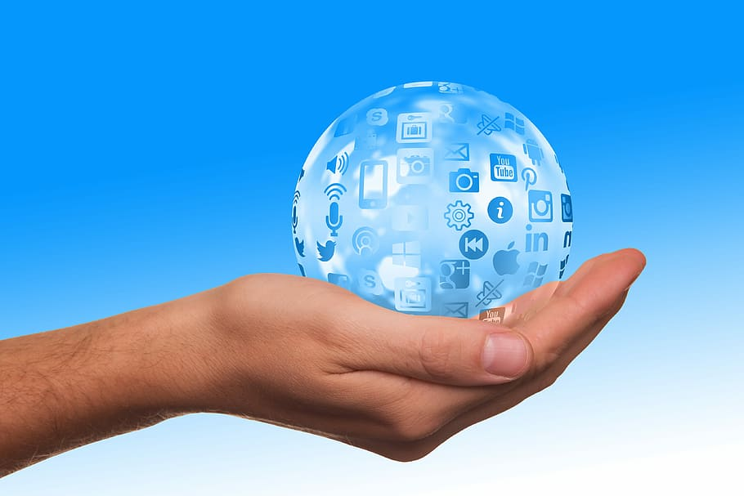
Real-World Applications of Code
E-commerce: Code powers online shopping experiences
Communication: Social media, email, and instant messaging
Entertainment: Streaming, gaming, and digital media
Healthcare: Digital records, telehealth, and medical research
…

Slide 9
Programming in Everyday Devices
Communication: Smartphones and apps
Home automation: Thermostats, lights, and security systems
Wearable technology: Fitness trackers and smartwatches
Automotive and transportation: GPS, self-driving cars
Entertainment and media: streaming devices, gaming consoles

Slide 10
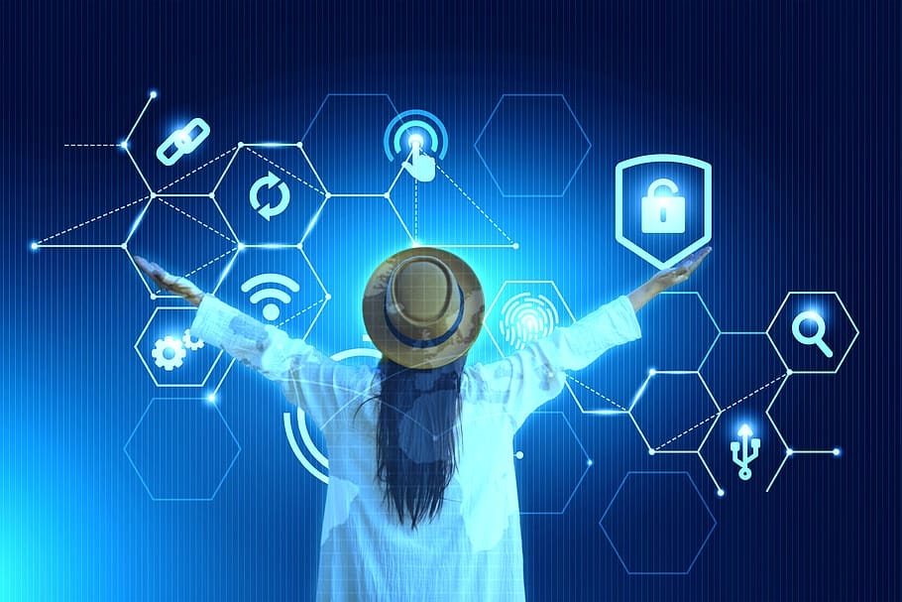
In the Business World
Automation of business processes
Data analytics for informed decisions
Digital marketing and customer engagement
E-commerce and the digital marketplace
Remote work and virtual collaboration

Slide 11
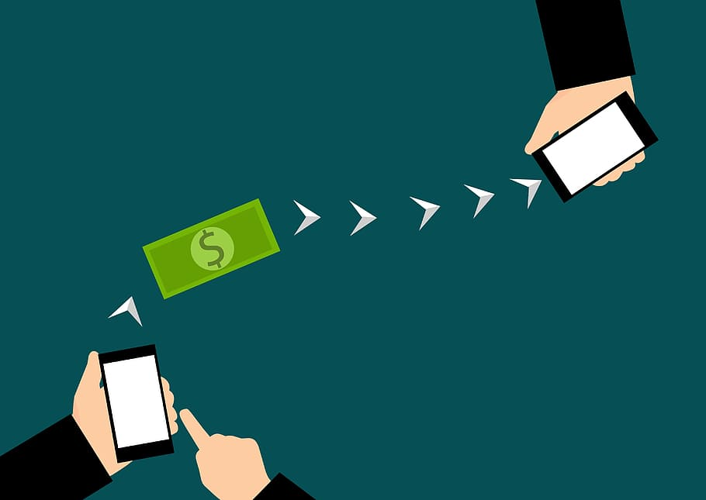
Banking and Finance
Digital banking and mobile apps
Automated trading and stock predictions
Fraud detection and risk assessment algorithms
Personal finance and wealth management
Innovation in payment systems
Managing customer information
Data analytics for customer insights
Digital banking experiences
New inventions: blockchain and web3

Slide 12
Societal Impact
How code has influenced communication and information dissemination
Blogging, search engines, instant messaging
The role of programming in education and remote learning
Coursera, Khan Academy, Udemy
Community building: Social media, forums, and online groups
Niche communities, specialized forums, crowdsourcing
Impacts on entertainment and culture
Streaming services, Gaming platforms, NFTs
Influencing social movements and activism
Viral campaigns, online petitions, political impact

Slide 13

The Future of Programming
The rise of AI and machine learning
Augmented reality (AR) and virtual reality (VR) experiences
Sustainable and responsible tech development

Slide 14
Thank you!
Q & A

